Slide 1
To Hyperscale or not to Hyperscale, that's the question
Reitse Eskens
He/Him
Dataplatform Consultant
Axians Business Analytics

Slide 2

Reitse
Eskens
He/Him
Dataplatform Consultant
Production DBA / Performance tuning
Azure infrastructure with Terraform
SQL training
Photography, running, cycling
Public speaker
Axians Business Analytics
Reitse.eskens@axians.com
@2meterDBA

Slide 3
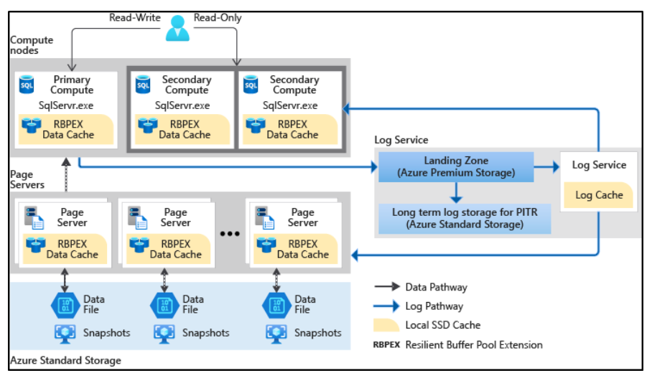
Hyperscale, general design

Slide 4
Hyperscale!
It’s really fast (less to no log waits)
It scales in the background
You can scale it when needed
Costs are related to the running setting

Slide 5
Hyperscale?
It’s not always that fast
Scaling means a failover
Don’t forget to scale down
Scaling loses most of your DMV contents
Scaling loses your buffered execution plans
Querystore doesn’t seem to suffer

Slide 6
Hyperscale bug
Do not upgrade a database to Hyperscale
The underlying design breaks
Weird waits
No performance at all

Slide 7
To Hyperscale or not to Hyperscale, that’s the question
Reitse Eskens
Reitse.eskens@axians.com
@2meterDBA

